Slide 1


Diabetes Prediction Using Machine Learning
This presentation explores the application of machine learning in predicting diabetes, a significant healthcare challenge.
by Unim Agiande

Slide 2

Project Overview
1
Global Impact
2
Key Objectives
Diabetes affects millions worldwide, posing significant health and economic burdens. Early detection through predictive analytics is crucial for effective preventive care and improved health outcomes.
The project aims to develop a predictive machine learning model using patient health metrics, evaluate various algorithms for their accuracy and efficiency, and provide actionable insights for healthcare professionals.
3
Revolutionizing Healthcare
This project leverages the power of machine learning to advance diabetes care, ultimately enhancing patient well-being.

Slide 3
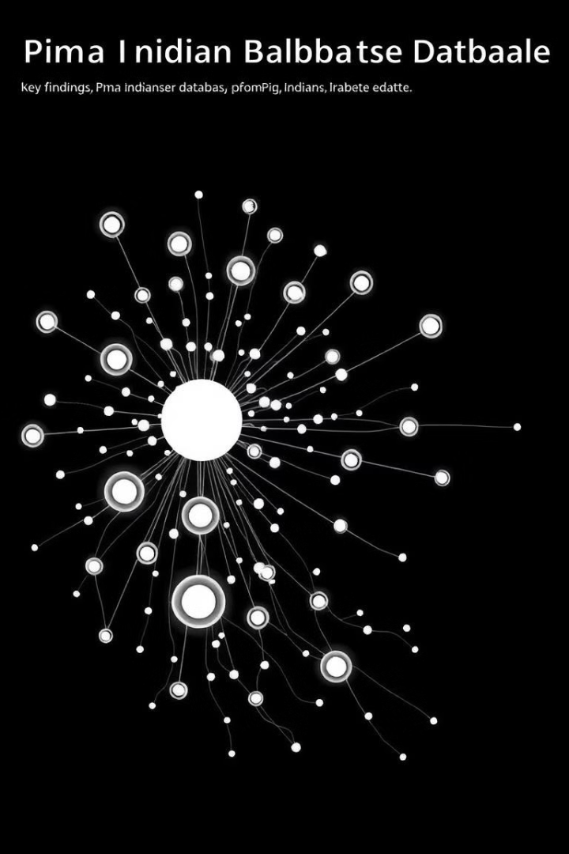
Dataset Overview
Dataset Source
Kaggle (Pima Indians Diabetes Database)
Dataset Features
8 input variables: Pregnancies, Glucose, Blood Pressure, Skin Thickness, Insulin, BMI, Diabetes Pedigree Function, and Age. 1 target variable: Outcome (1 = diabetic, 0 = non-diabetic)
Dataset Size
768 samples, split into 65% non-diabetic and 35% diabetic cases.
Data Quality
Clean dataset with no missing values but skewed distributions for features like Insulin and Skin Thickness.

Slide 4
Exploratory Data Analysis (EDA)
Data Understanding
Key Findings
EDA aims to understand data distribution, detect correlations, and identify preprocessing requirements.
Glucose levels showed the strongest correlation with diabetes outcome. BMI and Diabetes Pedigree Function were also important predictors.

Slide 5
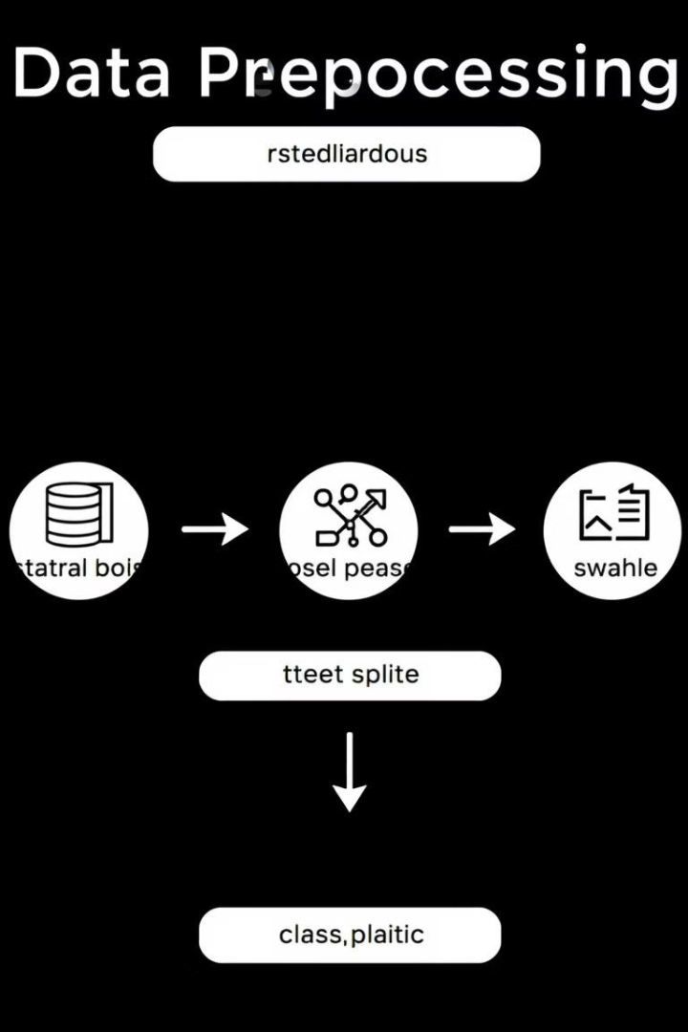
Data Preprocessing
1
Standardization
Applied StandardScaler to normalize features and ensure consistent scales for model training.
2
Class Balancing
Addressed data imbalance using techniques like oversampling or undersampling to prevent bias in model training.
3
Data Splitting
Divided the dataset into training (80%) and testing (20%) sets for model evaluation.

Slide 6
Machine Learning Models
Logistic Regression
Random Forest
SVM
A simple and interpretable model for binary classification, suitable for understanding the relationship between features and diabetes outcome.
An ensemble learning method that combines multiple decision trees to improve accuracy and reduce overfitting.
A powerful algorithm that finds an optimal hyperplane to separate data points into different classes.
KNN
Neural Networks
Gradient Boosting
A non-parametric method that classifies data points based on their similarity to nearest neighbors.
A complex model inspired by the human brain, capable of learning non-linear relationships in data.
An ensemble learning technique that combines multiple weak learners to improve predictive accuracy.
XGBoost
A highly efficient and robust algorithm for gradient boosting, known for its performance on large datasets.

Slide 7

Model Comparison
Model
Accuracy (%)
Gradient Boosting Classifier
91.45
SVM
90.79
Logistic Regression
89.47
Random Forest
89.47
KNN
88.16
XGBoost
88.16

Slide 8




Key Outcomes
High Accuracy
Developed a Gradient Boosting Classifier with 91.45% accuracy for diabetes prediction.
Healthcare Application
Demonstrated the utility of advanced machine learning methods in healthcare.
Scalable Pipeline
Produced a scalable pipeline ready for deployment in clinical settings.

Slide 9


Next Steps
Deployment
Deploy the model in real-time healthcare systems for accurate and efficient diabetes predictions.
Expansion
Expand testing to diverse and larger datasets for improved model generalization and robust predictions.
Interactive Dashboard
Develop an interactive dashboard for visualizing predictions and providing actionable insights to healthcare professionals.

Slide 10

Closing Remarks and Q&A
Thank you for your time. This project highlights the potential of machine learning for improving diabetes care and patient outcomes.
I am open for questions and discussions.
Contact: Unim Agiande, euagiande@gmail.com

